Slide 1
Understanding microbiome experiments: a critical assessment of methods and data analysis
Greg Gloor
Department of Biochemistry
University of Western Ontario
ggloor@uwo.ca @gbgloor
https://github.com/ggloor/compositions/presentations

Slide 2
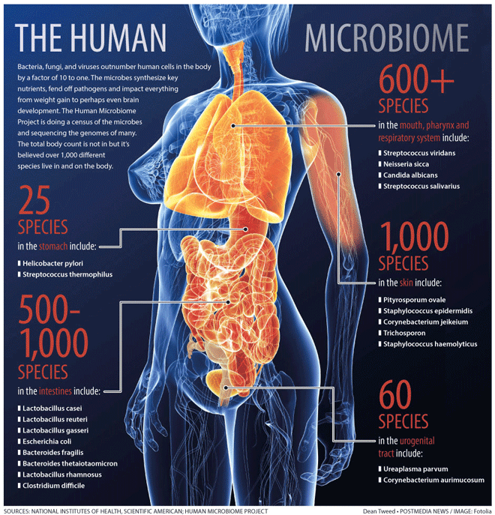
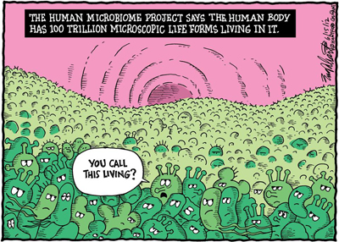
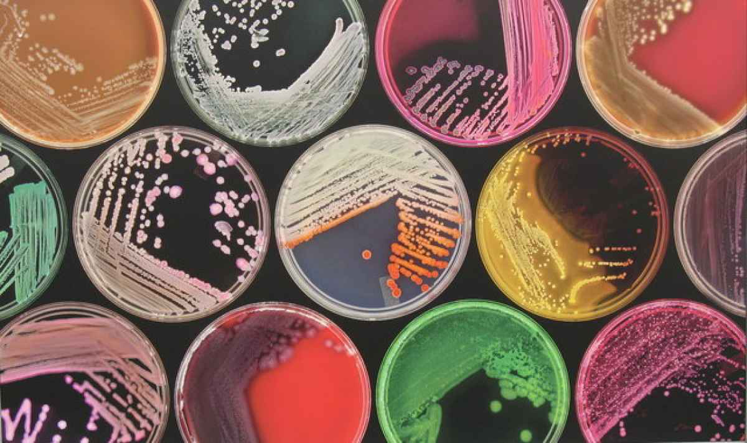
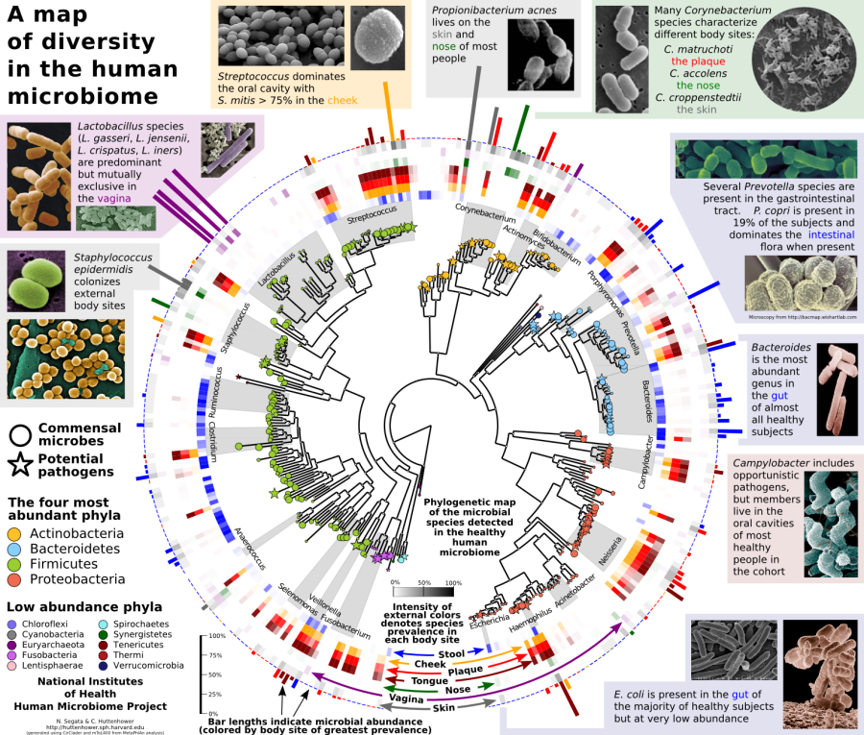
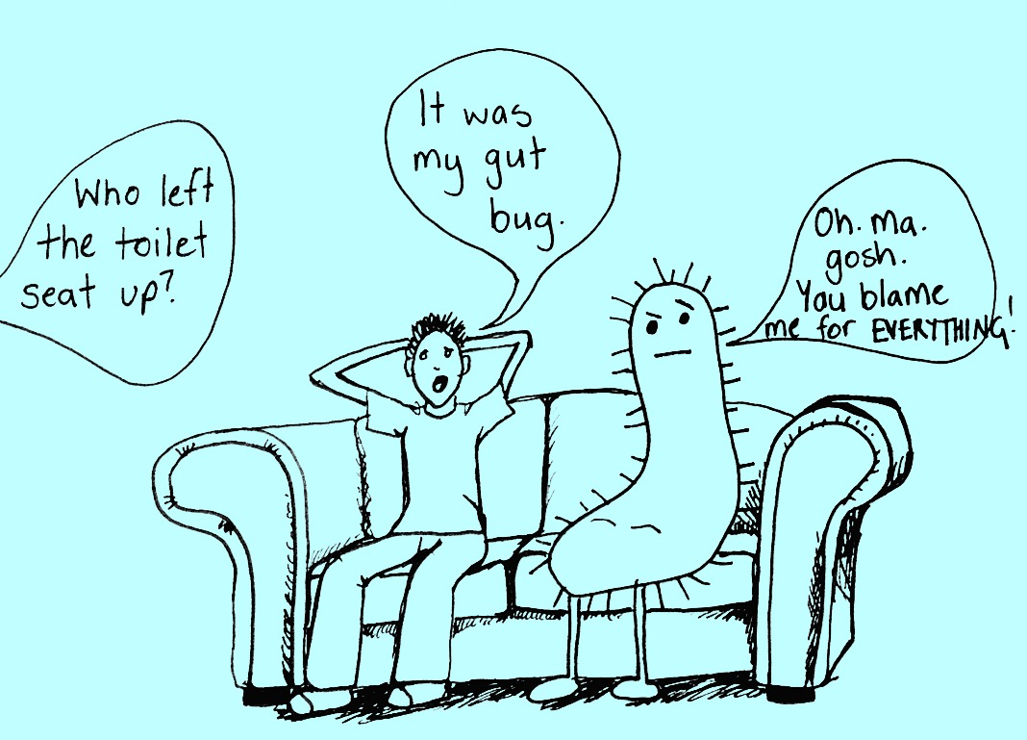
The microbiome

Slide 3
Major issues
Results are expensive to generate and to validate
Current methods may be suitable but no guarantee!
False positive results
Both for difference and correlation
Researcher degrees of freedom (RDF)
False negative results
Different wet lab protocols
Fit of data to statistical models
Insufficient power because of cost

Slide 4
Some solutions
Better databases now available
Almeida et al: Nature 2019
Cheaper methods available
Shallow shotgun: Hillmann mSystems 2018
Consistent wet-lab protocols
More principled and consistent analytic methods
Probabilistic + compositional data approaches: Gloor Frontiers 2017

Slide 5
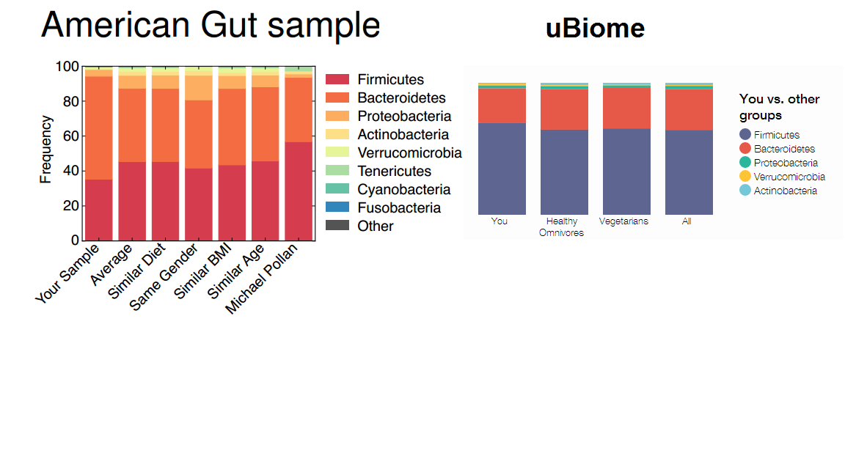
Is microbiome analysis reproducible?
Engelhaupt ScienceNews 2014
Here’s the poop on getting your gut microbiome analyzed
Notes:
no

Slide 6
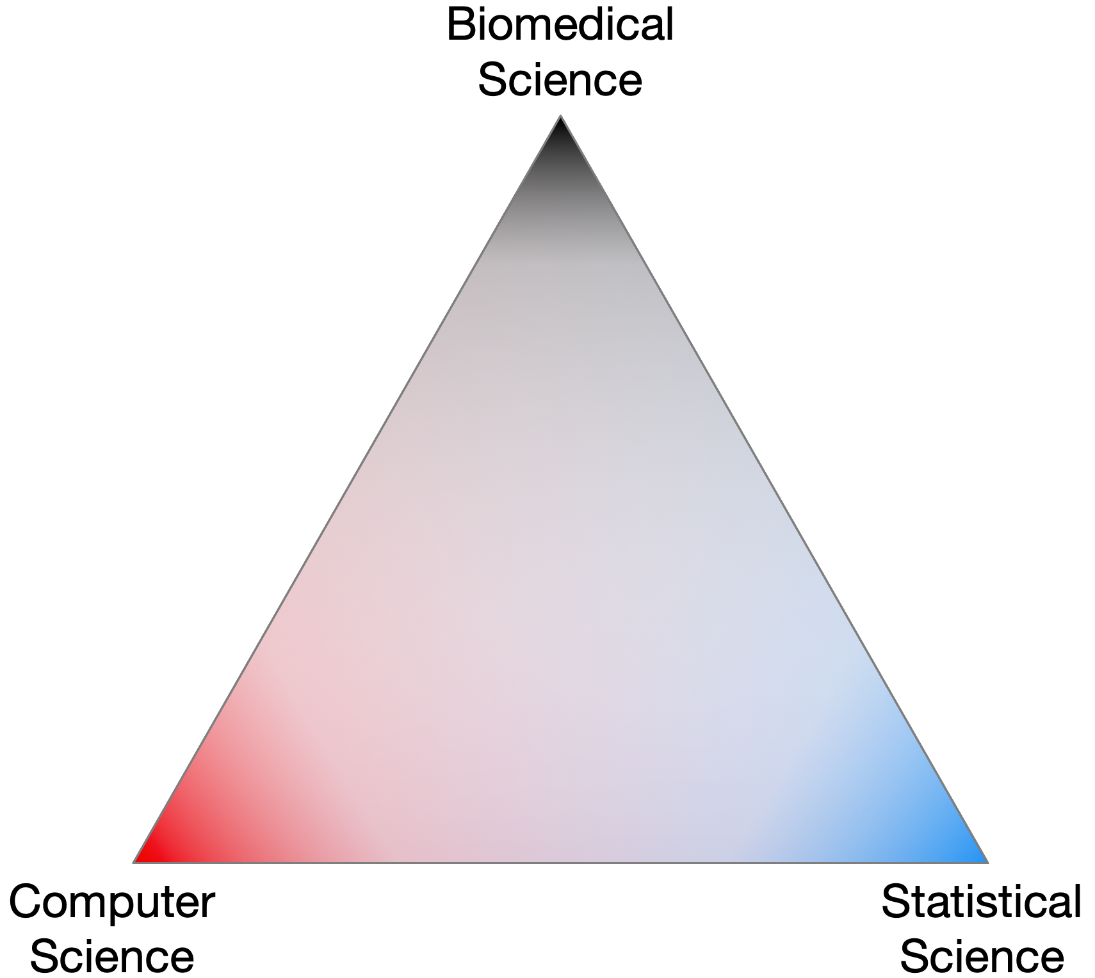
The triangle of trust
Notes:
Complex data and everyone trusts everone else without necessarily having the domain-specific expertise needed

Slide 7
Nobody sees the whole elephant

Slide 8
Wet lab researcher degrees of freedom
RDF are nearly infinite in the design
Notes:
Every choice along the way changes the results. Early data from pyrosequencing and V1-3, almost all later data collected on Illumina and V4

Slide 9
Bioinformatic researcher degrees of freedom
Notes:
It is common to apply open or close OTU picking, to try rarefying or RLE transform, then to use Bray-Curtis, JSD, W and UW unifrac on the same dataset. Results are cherry picked. This is a major source of FP. The probabalistic Bayesian + log-ratio approach is internally consistent and robust

Slide 10
We have a problem
RDF is a major red flag when evaluating paper
Is it any wonder that different groups can get different answers about the same system?
Is it any wonder that so many datasets are irreproducible?
So much variation, no standard of truth
Perceived need to be first not the need to be correct

Slide 11
Partial solution: functional but not microbial redundancy
Louzupone et al Nature 2012

Slide 12
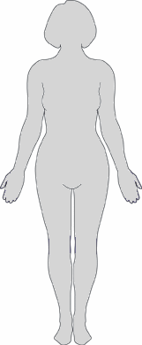
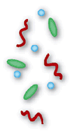
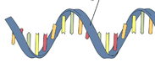
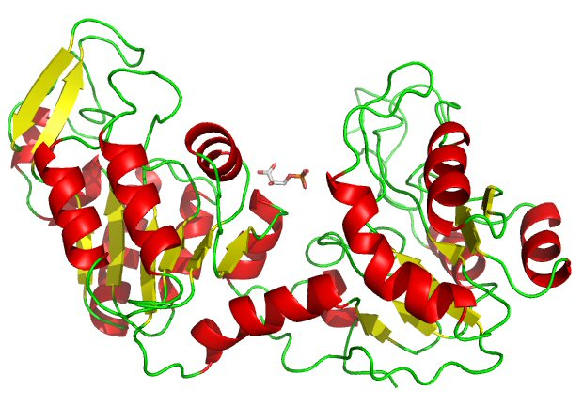
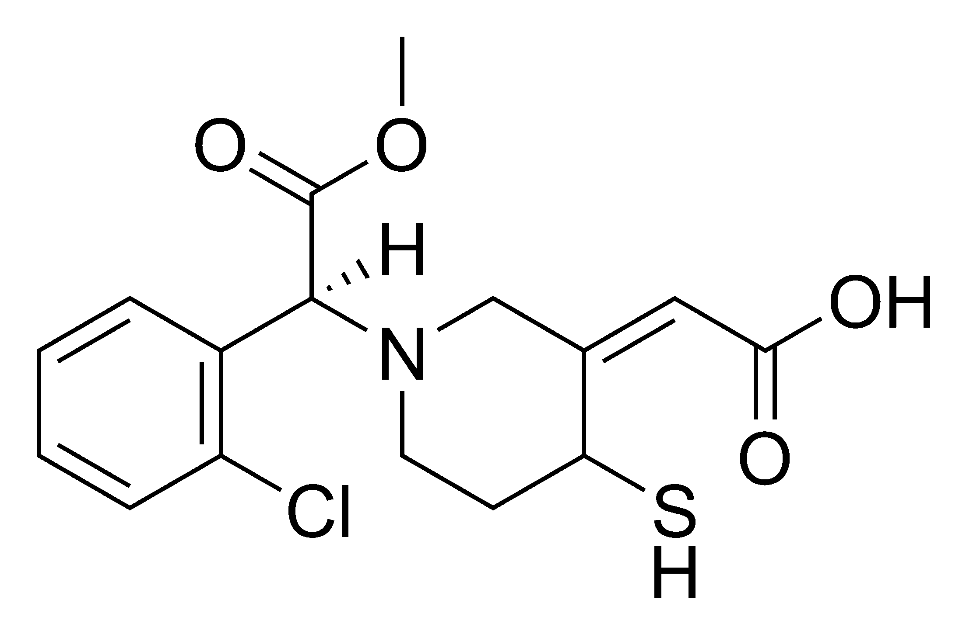


Getting to mechanism in the “meta-organism”
Jean Macklaim
Microbiome
Targeted amplicon seq (e.g. 16S)
High-throughput sequencing
Metagenomics
Metatranscriptomics
Proteomics
Metabolomics
DNA
mRNA
Proteins
Metabolites
Macklaim, Gloor. From RNA-seq to Biological Inference: Using Compositional Data Analysis in Meta-Transcriptomics. MIMB 2018
Notes:
So there’s no doubt that microbes influence their environment
A major challenge of any microbiome investigation is to determine the role of the microbes in the environment, and the effects on the host or system
In terms of human health, there are many open questions of what (if any) role our resident microbiomes have on disease progression or maintenance of health, etc.
Different “levels” of using “high-throughput omics” to probe the microbiome
And these different levels seek to address: Who’s there, what are they capable of, what are they doing, what are they producing

Slide 13
The sequencing meat grinder
Assumptions do not fit
Counts
Majority invariant
Dispersion ~ abundance
Model as NB or ZIG
Correlation
Gloor, et al. 2016. Ann Epidemiology
Gloor, et al. 2016. Can J. Micro.
Gloor, et al, 2017. Front. Micro.

Slide 14
Sequencing is random sampling - polling
Gloor, et al. 2016. Ann Epidemiology
Gloor, et al. 2016. Can J. Micro.
Gloor, et al, 2017. Front. Micro.
Notes:
Starting with a of molecules composed of Tigers and Ladybugs
We take a random sample, how many Tigers and how many Ladybugs
If we count a given random area we can infer how many off each there are in entire set

Slide 15
We need multiple polls to approximate truth
Gloor, et al. 2016. Ann Epidemiology
Gloor, et al. 2016. Can J. Micro.
Gloor, et al, 2017. Front. Micro.

Slide 16
Random data as counts
Example 100 random sample sets
range=1800-2200
range= 8000-12000
range=450-550
Gloor, et al. 2016. Ann Epidemiology
Gloor, et al. 2016. Can J. Micro.
Gloor, et al, 2017. Front. Micro.

Slide 17
Same random data after sequencing
Constant sum
Sequencing
Percentage,probability, etc
Count normalization
Rarefaction
Obviously not numeric
Obviously correlation is problematic
Gloor, et al. 2016. Ann Epidemiology
Gloor, et al. 2016. Can J. Micro.
Gloor, et al, 2017. Front. Micro.

Slide 18
Normalization is no help at all
Counts
Sequenced
Normalized (DESeq)
Once data are on the simplex, they cannot be recovered without
⌛️ 💲 🏋🏼‍

Slide 19
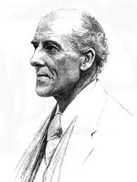
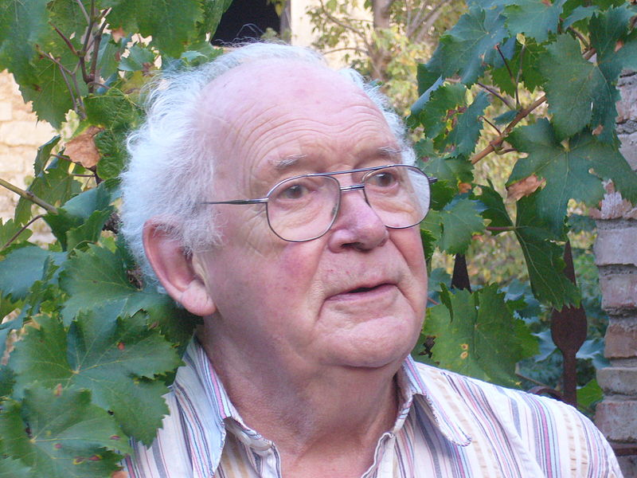
We have CoDa
Compositional data are logically inconsistent with most tools in common use (Pearson 1897)
correlation, PCA etc.
Sequencing, negative binomial, rarefaction, ZIG
Work in log ratios
Aitchison and others
Conceptually similar to qPCR
X = [ x₁, x₂, … x_{D} ], g_{X} = geometric mean of X (or subset)
*lr(x) = [ log(x₁/g_{X}), log(x₂/g_{X}), … log(x_{D}/g_{X}) ]
Aitchison 1986

Slide 20
Example using Bacterial vaginosis
H is predominantly Lactobacillus sp.
BV is mixed bag of anaerobes with L. iners
Marked asymmetry in composition
We must assume something is invariant
Good example dataset since have a good idea of the ‘truth’
Exploratory biplots
Differential abundance
Compare datasets

Slide 21
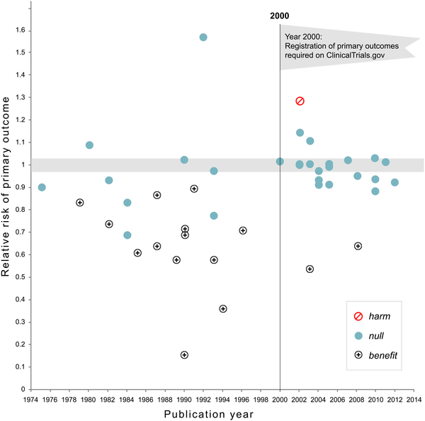

The importance of an analysis plan: reduce RDF
NHLBI trials on pharmaceutical and dietary supplement
Kaplan RM, Irvin VL (2015) Likelihood of Null Effects of Large NHLBI Clinical Trials Has Increased over Time. PLOS ONE 10(8): e0132382. https://doi.org/10.1371/journal.pone.0132382
https://journals.plos.org/plosone/article?id=10.1371/journal.pone.0132382
Notes:
Fig 1. Relative risk of showing benefit or harm of treatment by year of publication for large NHLBI trials on pharmaceutical and dietary supplement interventions.

Slide 22
The CoDa approach
Backed by theoretical foundation
Not ad-hoc or adapted
Gives same answer with sequence data and counts
Based on variance not abundance
Internally consistent
Univariate and multivariate agree
Probabilistic
Matches the data
Robust
Upstream decisions have less effect

Slide 23
Example sample set by 16S rRNA gene sequencing
Healthy
Bacterial Vaginosis (BV)
Notes:
Here’s as example to show you what I mean
This is the 16S rRNA gene sequencing output of the human vaginal microbiome. Each bar is a sample and each color is a taxonomic member of the community
Under typical healthy conditions is it a low diversity community with each sample dominated by one species of these blue Lactobacilli
A dysbiotic shift can happen where there is a drastic change to a high-diversity community called bacterial vaginosis (BV) on the right. You can hopefully see they are quite different communities
Click: Some organisms change abundance, like Lactobacillus iners
Click: Some organisms present in one condition are almost entirely absent in another like Atopobium

Slide 24
Metatranscriptomics (ie. meta-RNAseq)
Bacterial mRNA seq
Reference genome CDS
Assembly of novel ORFs
90% sequence ID clustering: refseqs
Part 1
Organism-specific
Read mapping
Part 2
Group by SEED subsys4
Function
Macklaim, Gloor MIMB 2018
Notes:
This is a very distilled down workflow for how we generated the data
There are a few steps before, but we get to a point where we have enriched bacterial mRNA reads
We then do two things:
1. Collect putative coding sequences from reference genomes
Assemble de-novo and predict open reading frames (ORFs)
The sequences are clusters into 90% sequences identity refseqs that we map to
From these we retain the organism or taxonomic information
But we also take those refseqs and group them functionally using the SEED subsystem database

Slide 25
Part 1: Abundance != function
Notes:
These are the same data I just showed you, but represented in taxonomic abundance barplots at both using 16S (top) and by mRNA (bottom)
By hierarchical clustering of the transcriptome, there are four main subgroups: two associated with health on the left in blue, and two associated with BV on the right
What I want to show you is the difference between the taxonomic contributions at the 16S level (the top plot) compared to the taxonomic contributions from the mRNA level (bottom plot)
This is summarized per taxon in the boxplots on the left
In some cases, like the blue L. crispatus organism, it’s punching above it’s weight and contributing more transcriptionally than you’d expect
And in other cases, like the white Atopobium organism there is hardly any transcriptional activity compared to the 16S abundance

Slide 26
Part 1: Reference sequence pangenomes
Variance of ratios of RefSeqs
~300000 RefSeqs
RefSeqs cluster
by ‘species’

Slide 27
Part 1: Reference sequence pangenomes
Variance of ratios of RefSeqs
~300000 RefSeqs
RefSeqs cluster
by ‘species’
Genomes cluster because of shared function (Almeida 2019) and expression (this data)
L. iners
L. crispatus
Megasphaera
Megasphaera

Slide 28
Part 1: Reference sequence
Healthy samples also cluster by species
BV samples separate by expression of Megasphaera and an unknown species
H2
BV-2
H1
BV-1

Slide 29
Part 1: Summary
Massive sparse datasets
~300k refseq genes
Refseqs group by taxonomy and expression
Can be multiple ‘strains’
Samples group by taxonomy and function
Two types of healthy samples
Two types of BV samples

Slide 30
Part 2: Function
Group refseqs by same function
Examine at the ecosystem rather than the organism level
e.g. sum counts for the gene for each enzyme (structural protein, etc) in all organisms
Taxonomic information is lost
Reduces from 300k genes to ~8000 functions
Sparsity is much reduced
Generally more robust, but …

Slide 31
Part 2: The importance of sample collection and handling
Vaginal meta-transcriptome from 2 groups.
Same sequencing platform, & read processing & bioinformatics
Analyzing function-but…
Samples separate by BV status and by group
Sample collection and handling different
Healthy
Int
BV
Group A
Group B

Slide 32
Part 2: Function - platform
But: platform has negligible effect if sampling methods are the same
Highlighted samples from ABI-Solid
All others Illumina HiSeq
BV-2
H-1,2
BV-1

Slide 33
Part 2: Function - samples
BV-2
H-1,2
BV-1

Slide 34
Part 2: Core functions assumed invariant
Housekeeping …
Cell division protein MraZ
D-tyrosyl-tRNA(Tyr) deacylase
Deoxyuridine 5'-triphosphate nucleotidohydrolase (EC 3.6.1.23)
DNA ligase (EC 6.5.1.2)
FIGfam135315: Iojap-related protein
LSU ribosomal protein L3p (L3e)
Membrane-associated zinc metalloprotease
Peptide chain release factor 3
Ribosomal large subunit pseudouridine synthase B (EC 4.2.1.70)
Signal peptidase I (EC 3.4.21.89)
Transcription-repair coupling factor
Translation elongation factor Ts
tRNA nucleotidyltransferase (EC 2.7.7.21) (EC 2.7.7.25)
Tryptophanyl-tRNA synthetase (EC 6.1.1.2)
core

Slide 35
Part 2: Function groups
BV-2
BV = biosynthesis/TCA
H = aa/sugar
H
BV-1

Slide 36
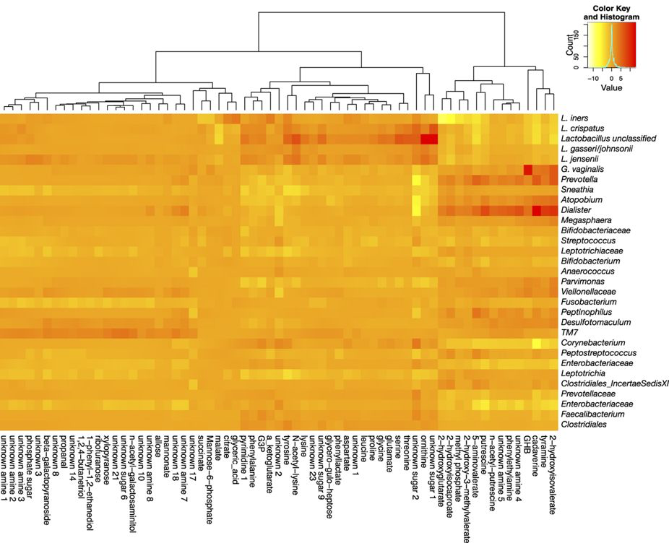
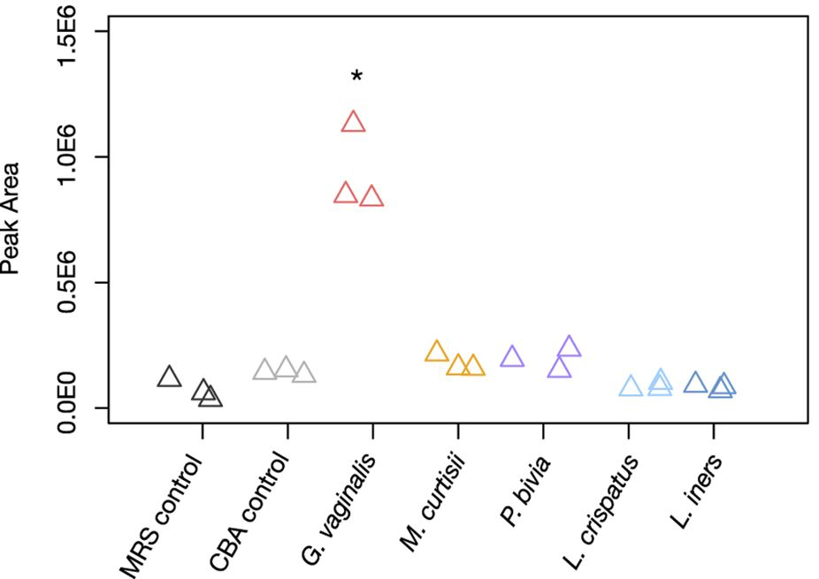
Merging metabolome, microbiome, metatranscriptome
G. vaginalis correlates with GHB
G. vaginalis has part of the pathway to make GHB
G. vaginalis produces GHB in vitro
McMillan et al. 2015 Sci Rep

Slide 37
Part 2: Summary
Who is there, what they are doing and what they have done may or may not correspond between DNA, RNA, small molecules
Relationship status: it’s complicated but some successes
Combining different ‘omics data (e.g. mRNA and metabolites) remains an open problem
Metabolome + metaRNAseq provides a high-resolution, holistic view of a complex system
Agreements (H v BV: amines, succinate)
different resolution
Some functions are conserved regardless of the community members
Ecosystem is more important than any organism
Community members can cooperate, compete or ignore
Notes:
----------------------------------
Inferring from 16S would be misleading: organism abundance and transcript abundance not necessarily related….and out to small molecules detected
Still need virome and proteome, etc.
Describing the functional diversity through transcriptomics gives insight to the response of bacteria to changes in environment and potential effects on host
A better “omics” understanding will allow us to target and modulate the microbiome in predictable ways

Slide 38
Summary: Sources of variability (MBQC)
Specimen (biological)
Extraction (method)
Sample handling (method)
Bioinformatics (method)
Bottom line is that all methods must be consistent
Some reduction in methodological variation when using shotgun metagenomics
Sinha et al. Nat. Biotech. 35:1077 2017
Hillmann et al. Msystems 2019 doi:10.1128/sSystems.00069-18

Slide 39
Summary: Can microbiome analysis be made reproducible?
Wet lab methods should be standard in a study
The CoDa framework is robust and reflects properties of the entire composition
Not just most prevalent
Resist the RDF temptation
Notes:
Compositional data is analyzed based on the variance of the ratios between parts. Regardless of the approach the first step is to replace 0 values prior to clr transformation. This is an open problem, but the best current approaches incorporate Bayesian estimation. I am developing CoDaSeq, an integrated toolkit that adapts the tools used for compositional data analysis in other domains to the analysis if HTS. With these tools we can find outliers, perform exploratory data analysis, examine differential abundance and find associated variables. The toolkit is applicable to many different HTS designs including transcriptome, metagenome and 16S rRNA gene sequencing. The latter will be used as an esample, since these data are the least tractable to the CoDa approach

Slide 40
We must try harder to see the whole elephant

Slide 41
Available CoDa tools
Outliers & filters
CoDaSeq (github.com/ggloor)
Exploratory data analysis
Compositional biplots (compostions - CRAN)
omicplotR (Dan Giguere: github.com/dgiguer/omicplotR/wiki)
philr (Bioconductor)
Differential abundance
ALDEx2 (Bioconductor)
Selbal
ANCOM (QIIME)
Compositional association
propr (CRAN)

Slide 42

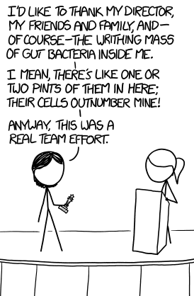


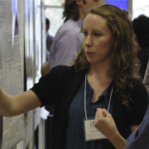



Acknowledgments
Andrew
Fernandes
Jean
Macklaim
Vera Pawlowsky-Glahn
Juan Jose Egozcue
Justin Silverman
philr
Tom Quinn
propr
Rob Finn group (EBI)
Gregor Reid
Jeremy Burton
Amy McMillan
Daniel Giguere
Jia Rong Wu
Notes:
Many more fragments than we can count

